Slide 1
Lattix Enterprise Suite
Understand, Define, and Control Software Architecture

Slide 2















About Lattix
Leading innovator of award-winning software architecture analysis software since 2004
Company and technology have roots at MIT
Products sold in 22 countries world-wide

Slide 3
Costs of software development
“Software maintenance costs about 80% of a software product’s total life-cycle costs, and 40% of that cost is software understanding” – IEEE Computer Society
Notes:
Numerous studies show maintenance consumes up to 80% of total software costs, keeping these costs down is vital

Slide 4
Architecture is essential
Architecture influences how fast we can respond to changes and what the costs of those changes are
Notes:
A clean architecture is crucial to keeping maintenance costs down

Slide 5
Software architecture today is:
Hard to understand
Hard to define and update
Hard to control
Notes:
Why isn’t there more focus on software architecture? It is hard to understand what your current architecture is, it is hard to update or define a new architecture, and once you have a clean architecture it is hard to monitor and enforce your architecture moving forward.

Slide 6
Lattix Architect makes software architecture:
Easy to understand
Easy to define and update
Easy to control
Notes:
Lattix Architect makes it easy to understand your current architecture, easy to update your architecture and easy to monitor and enforce it going forward.

Slide 7
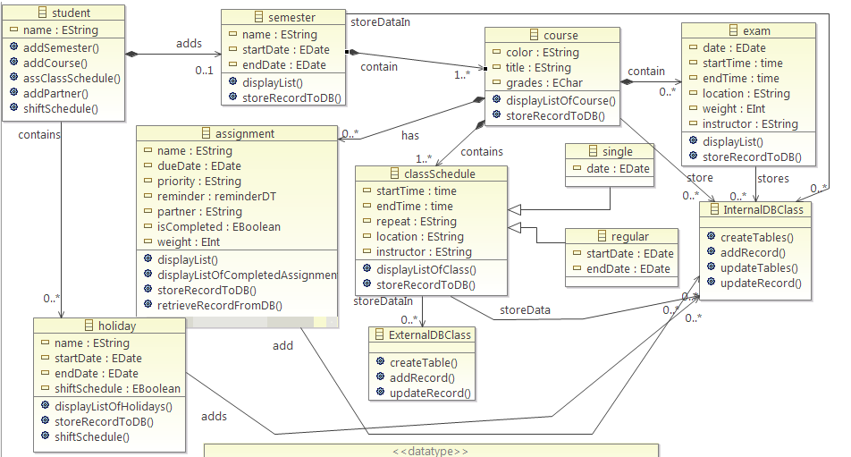
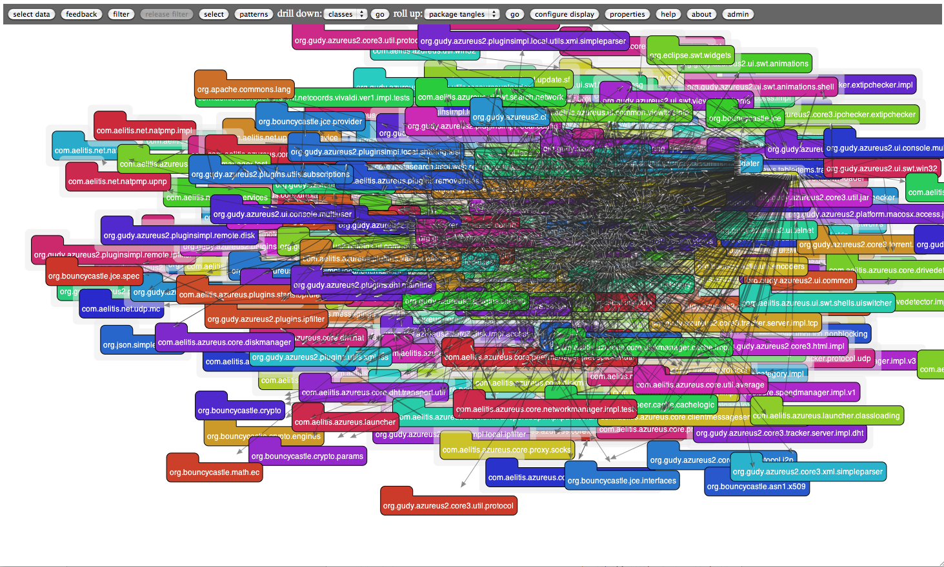
Scalability
This does not scale to large software projects
Notes:
Why do we need a revolutionary user interface?
Here is how most software architecture is drawn
Boxes and arrows. Something nice and easy like this.
What is wrong with this picture? At this scale nothing.
But what happens when you have 373 packages and 2698 classes as in this picture.
How do you make this architecture more modular? So that it is easily changed or upgraded in the future. How do you find bad dependencies or cycles? How do you monitor it going forward?
The problem is that box and arrows don’t scale to large software projects.

Slide 8
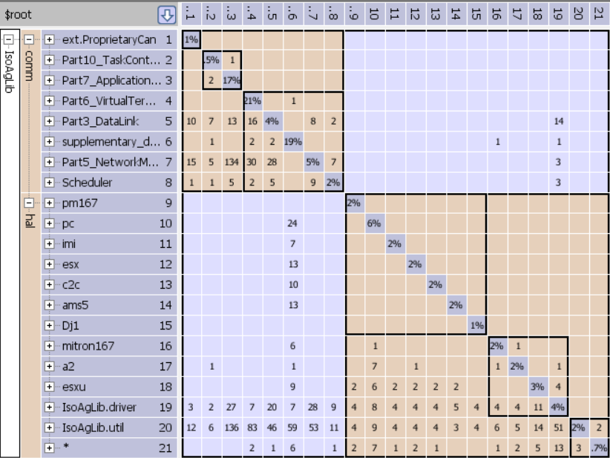
Dependency Structure Matrix (DSM)
Scalable visualization
Comprehensive architectural analysis
Support for multiple languages and technologies
Notes:
So how do we solve this problem?
It turns out we have solved it.
We solved it in complex product design 40 years ago.
We solved it with a dependency structure matrix (DSM)
This DSM technology has been applied to model products, processes and organizations in a variety of industries and areas, including aerospace, automotive, real estate, buildings, electronics, energy and pharmaceuticals.
As the number of elements grows, a box and arrow diagram begins to look like a large place to spaghetti and meatballs, whereas the DSM maintains its ease of readability.
Lattix is the first company to apply this technology to software

Slide 9
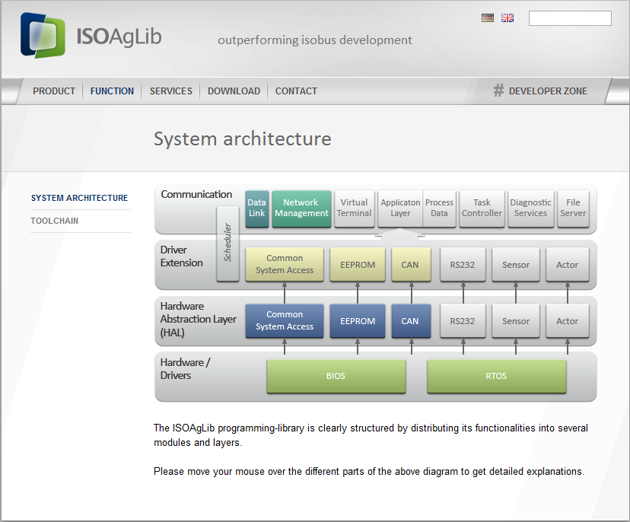
ISOAgLib: As defined
“clearly structured…into several modules and layers”
Notes:
Let me show you a real world example, here is the architecture of ISOAgLib. ISOAgLib is an open source library for electronic data communication. Here is the defined architecture.

Slide 10
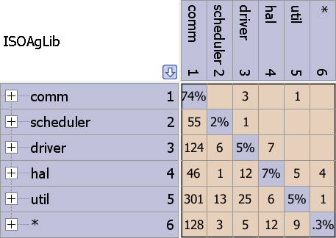
ISOAgLib: Discovered architecture
Problematic dependencies above the diagonal
New layer discovered that was not in defined architecture
Notes:
Here is the discovered architecture. We used a DSM analysis called partitioning to group elements according to their membership in a module.
Such modularity is helpful for finding problematic dependencies and layers that are not supposed to be part of the architecture. Fixing these issues increases software robustness and resiliency, among other benefits. In the as defined architecture, there are 4 layers. In the discovered architecture, there is one layer.

Slide 11
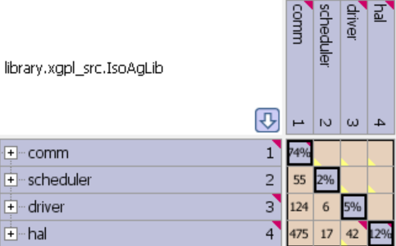
ISOAgLib: Refactoring in Lattix Architect
Notes:
Here is the “refactoring” architecture in Lattix Architect that reflects the 4 layers as seen in the intended architecture.

Slide 12
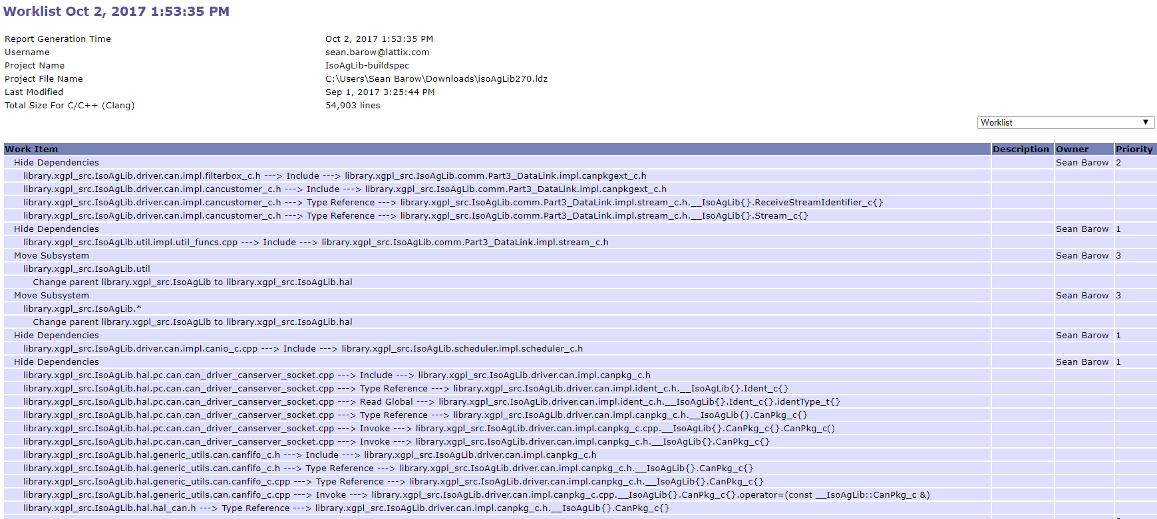
ISOAgLib: Worklist
Notes:
You can also create a worklist of everything that you need to do to “refactor” your architecture back to its intended form. The worklist items can be assigned an owner and given a priority.

Slide 13
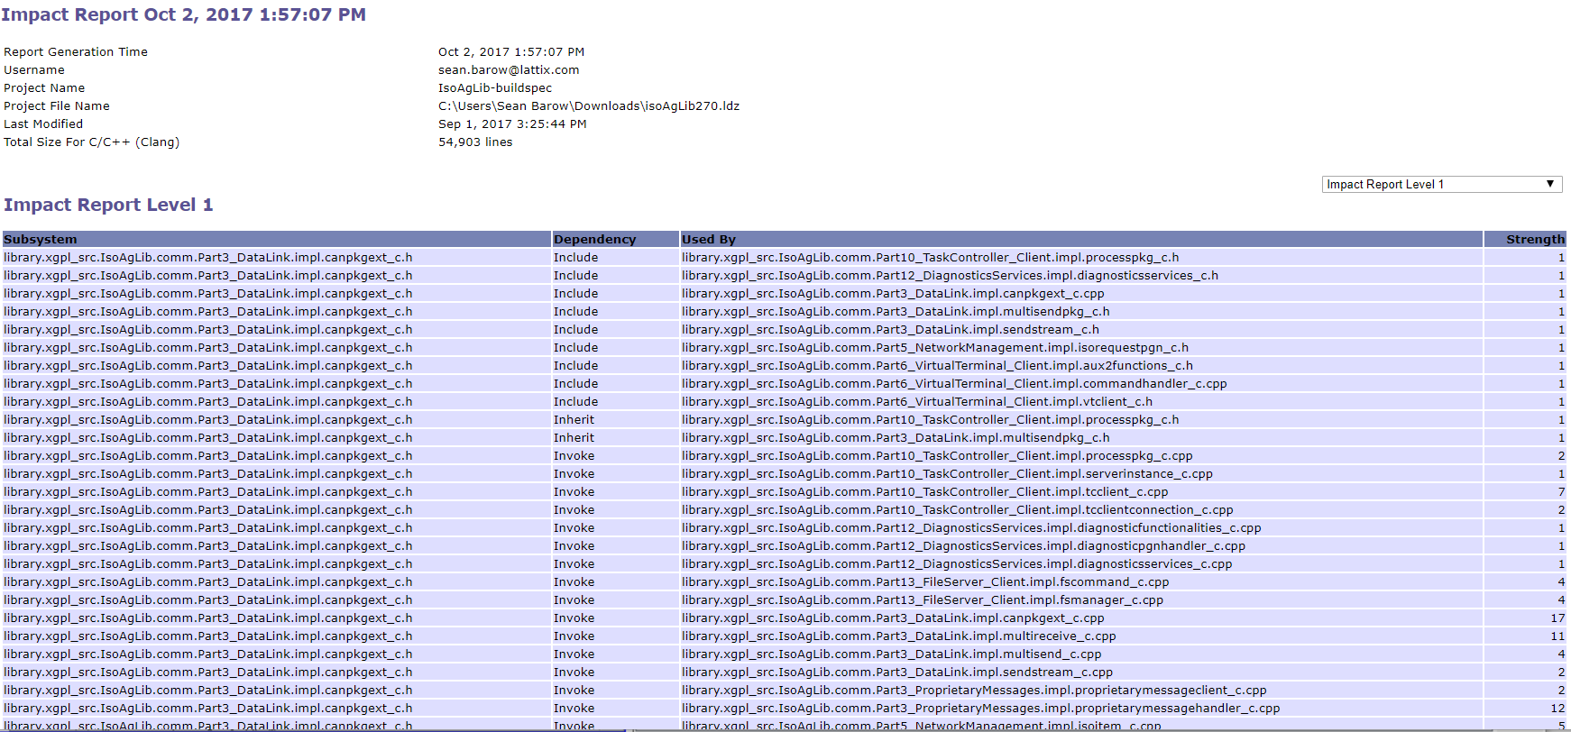
ISOAgLib: Impact Report
Notes:
For each worklist item, you can create an impact report to understand the level of work and testing that will be needed to complete this work item.

Slide 14
Design Rules – monitor evolution of the software
Control architecture erosion
Allow developers to have a clear understanding of the architecture when supporting new capabilities
DSM is a powerful way for setting and visualizing design rules

Slide 15
Design Rules - manage use of external libraries
Ensure licensing requirements are understood and met
Ensure correct libraries are used in terms of quality and security
Design rules allow or disallow the use of external libraries

Slide 16
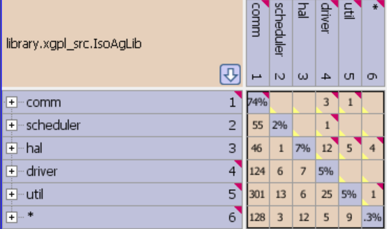
ISOAgLib: Create Rules
Notes:
Once you have the architecture in a good state, you create rules to monitor and enforce the architecture. Any violations can be seen in red on the DSM or viewed in a violations report…

Slide 17
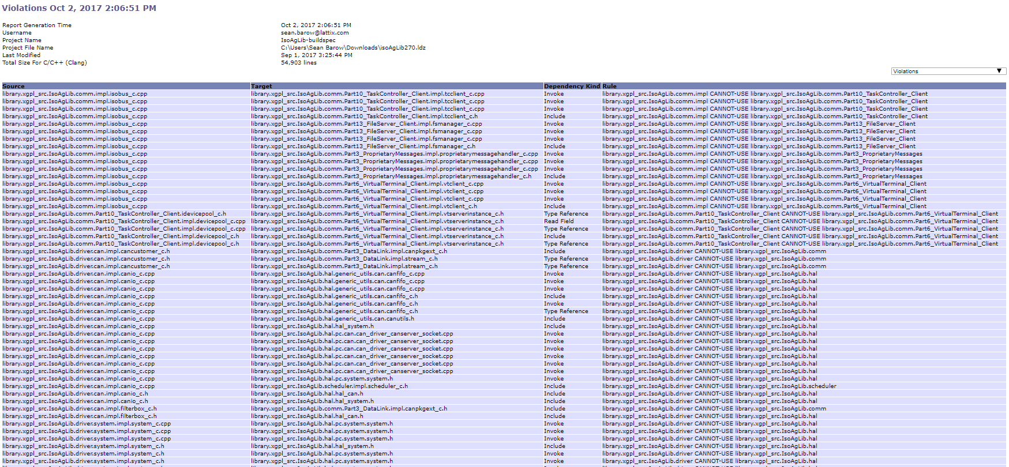
ISOAgLib: Violations Report

Slide 18
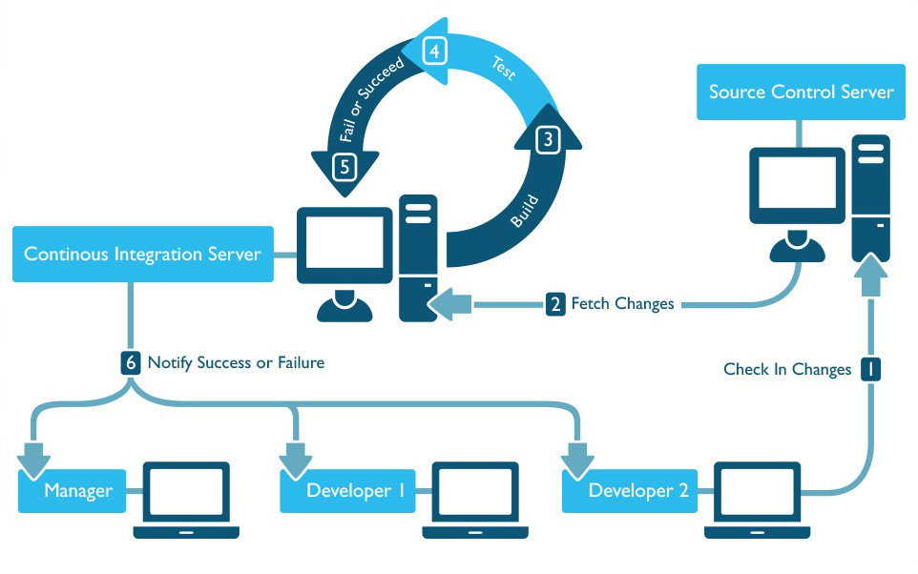

Lattix Enterprise Continuous Integration
Notes:
Lattix Enterprise can also be added to your continuous integration report to allow you to monitor and enforce the architecture on every check in.

Slide 19
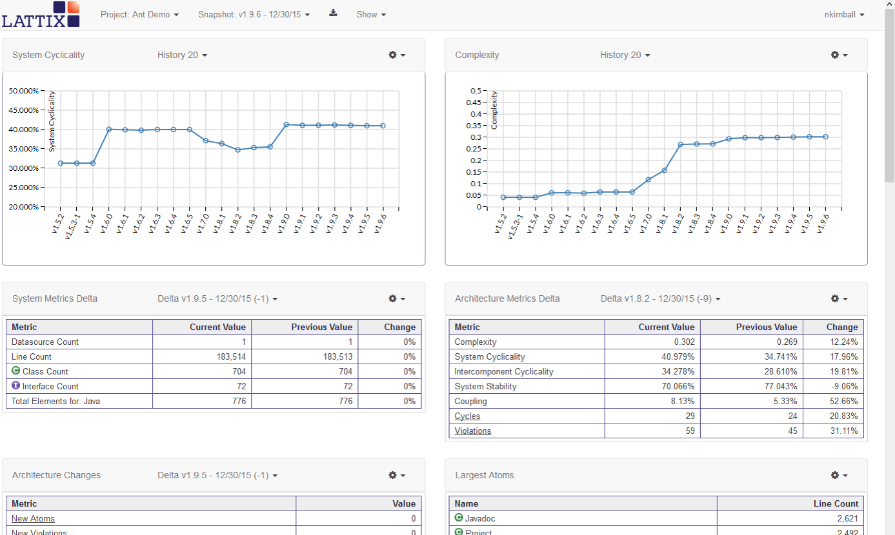
Lattix Web
Notes:
The changes between releases can be view in Lattix web. Which allows you to see changes over time to different metrics including….

Slide 20
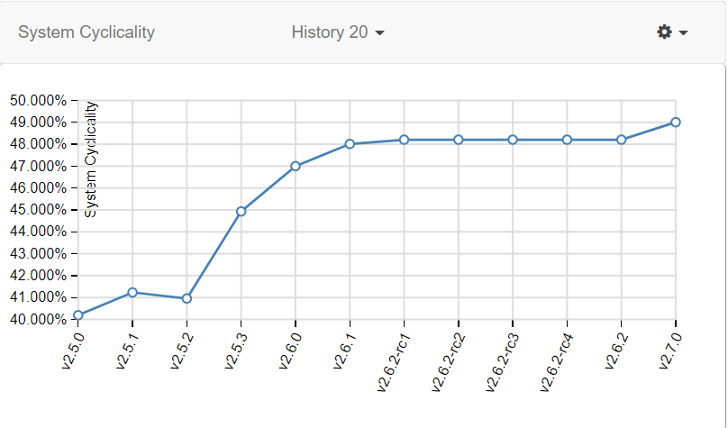
Cyclicality – predictor of bugs
Key determinant of undesirable coupling
Percentage of the system that is in some cycle

Slide 21
Stability – measure of architectural erosion
Data coupling – The dependence of a software component on data not exclusively under the control of that software component
Control coupling – The manner or degree by which one software component influences the execution of another software component
Lattix Uses Report – shows everything that’s used by selected components.
How much of the system is affected when a change is made
Low stability
Harder to maintain, error prone
Requires greater testing and validation
High stability
Robust, changes are localized
Easy for developer to understand

Slide 22
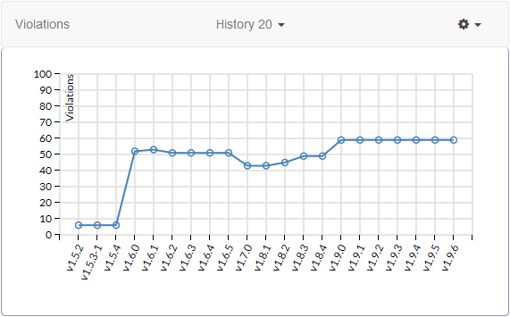
Violations
The number of Design Rule Violations that exist within the system for each build

Slide 23
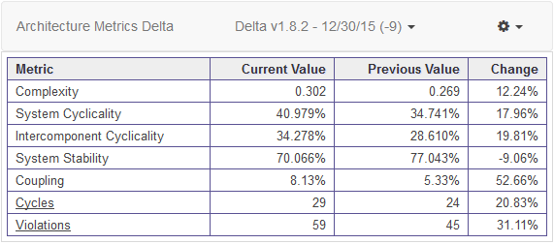
Architecture Metrics Delta
Compares the values of a variety of architectural metrics between two different snapshots of the project

Slide 24
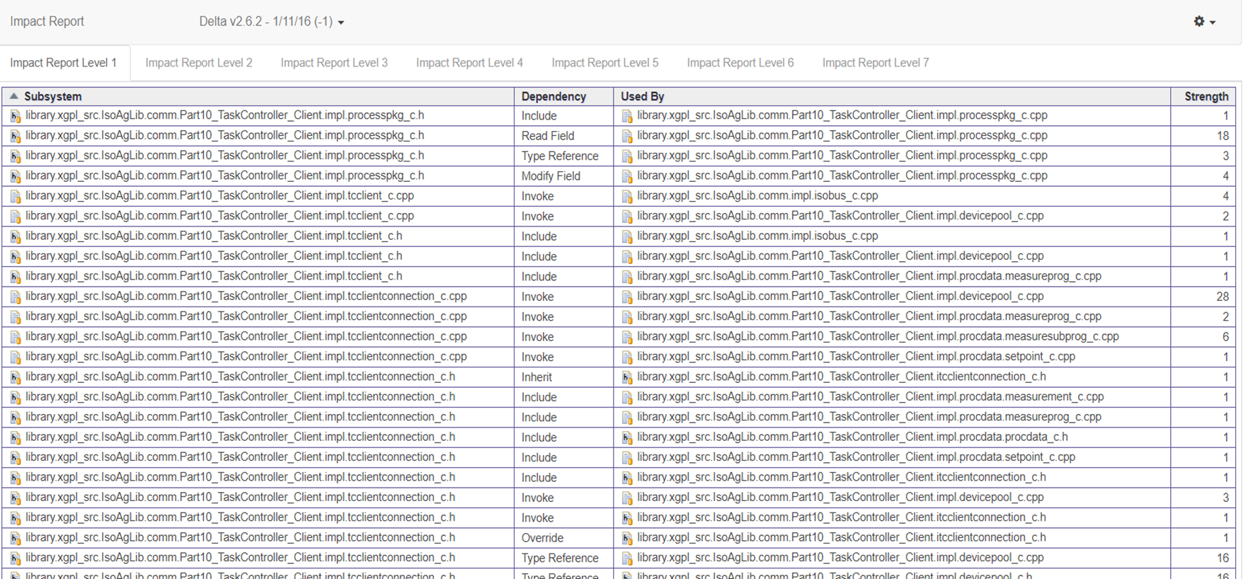
Impact of change between releases

